Slide 1
Data modeling
all the data that is now available from the client and ready for the modeling of the problem statement

Slide 2
This data model diagram shows:
● 3 tables:
○ sales = sales data
○ sensor_storage_temperature = IoT data from the temperature sensors in the storage facility for the products
○ sensor_stock_levels = estimated stock levels of products based on IoT sensors
● Relations between tables
○ These are shown by the arrows. Make note of the columns that connect the start and end of the arrows, this indicates how you can merge the tables using these linked columns.

Slide 3
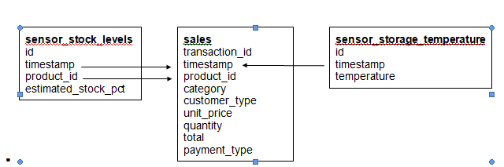

Slide 4
Data Model
For modelling data from all three tables will be used.

Slide 5
Plan
Data Preperation
Feature engineering (combining all 3 tables)
Building models and checking performance
Evaluation of models
QA

Slide 6
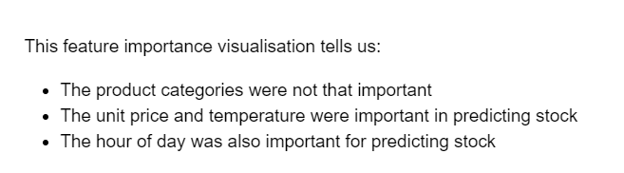
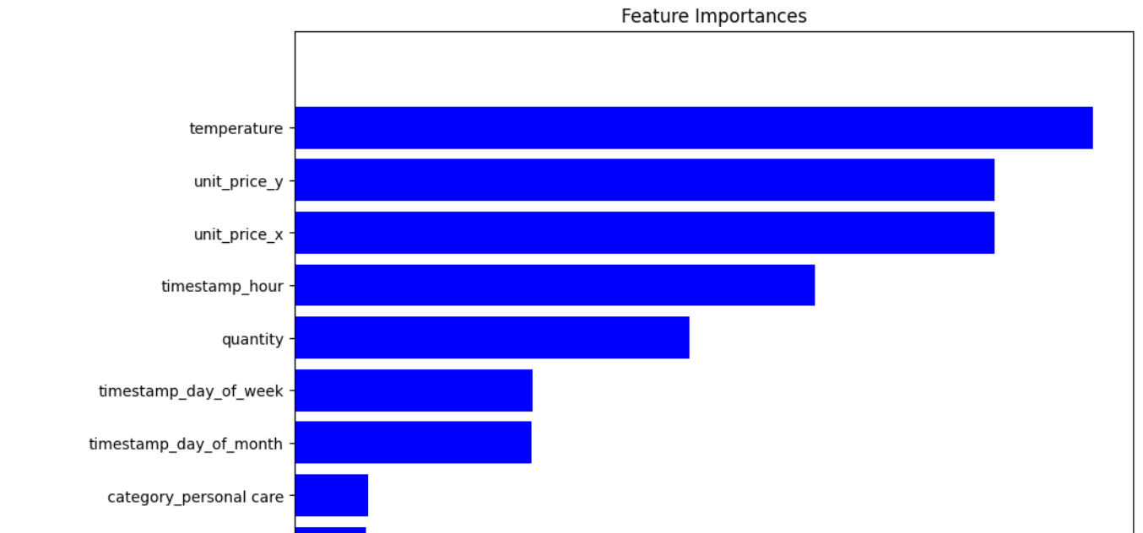
Model

